Slide 1
CS 513-B
Knowledge Discovery and Data Mining

Slide 2
SKYSCORE
Machine Learning for Passenger Satisfaction Insights

Slide 3




The Team - Group 13
Pradhyumna Nagaraja Holla 20032105
Rohi Dinesh Bindal 20031243
Sarah Murphy 20026527
Aditya Dineshkumar Champaneri 20029562

Slide 4
What drives passenger satisfaction in modern air travel?

Slide 5
The Problem

Slide 6
Airlines struggle to maintain consistent service quality across their extensive flight networks, leading to varying passenger experiences
Travelers demand personalized experiences and superior service across multiple sectors, from booking to baggage claim, making satisfaction management complex
Airlines face significant challenges in real-time monitoring of passenger satisfaction, often discovering issues only after receiving negative feedback
The industry lacks effective tools to predict and prevent customer dissatisfaction, resulting in reactive rather than proactive service improvements
Our objective is to develop a machine learning classifier that accurately predicts passenger satisfaction by analyzing key indicators, enabling proactive service enhancements and improved resource allocation

Slide 7
The Dataset
https://www.kaggle.com/datasets/johndddddd/customer-satisfaction/data

Slide 8
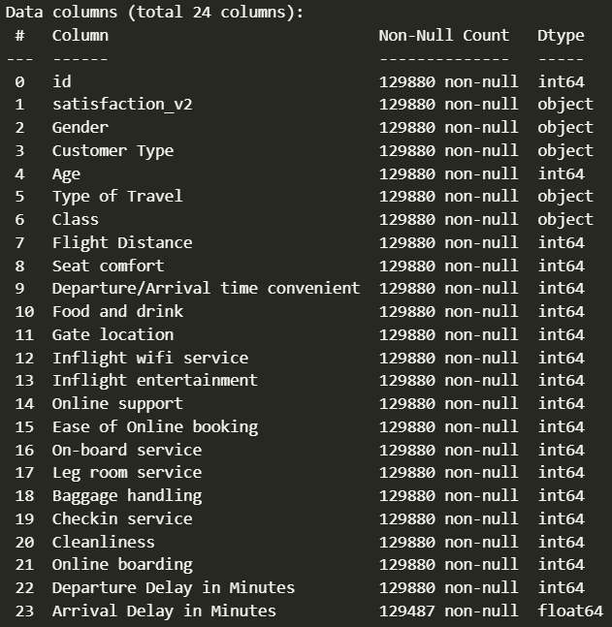
129880 rows, 24 columns, including the target
5 Categorical Columns, 19 Numerical Columns
Binary Target Variable: satisfaction - Satisfied/Neutral or Dissatisfied
Minimal missing values, hence they are removed
Most of the numerical values are ratings which span from 0 to 5

Slide 9
The target variable 'satisfaction' shows a balanced distribution with 55% satisfied and 45% dissatisfied passengers, enabling unbiased model training.
Customer loyalty data reveals a mix of 82% regular passengers and 18% non-regular travelers, providing insights into both experienced and new customer perspectives.
The dataset includes important pre-flight and post-flight metrics like ease of online ticket booking, departure/arrival delays etc., capturing the complete journey experience.
Service ratings follow a consistent 0-5 scale across 14 different aspects including seat comfort, cabin staff, and online booking, allowing standardized comparison.
Travel class distribution shows 48% Business class, 45% Economy class, and 7% Economy Plus passengers, representing diverse service level experiences.

Slide 10
Exploratory Data Analysis

Slide 11
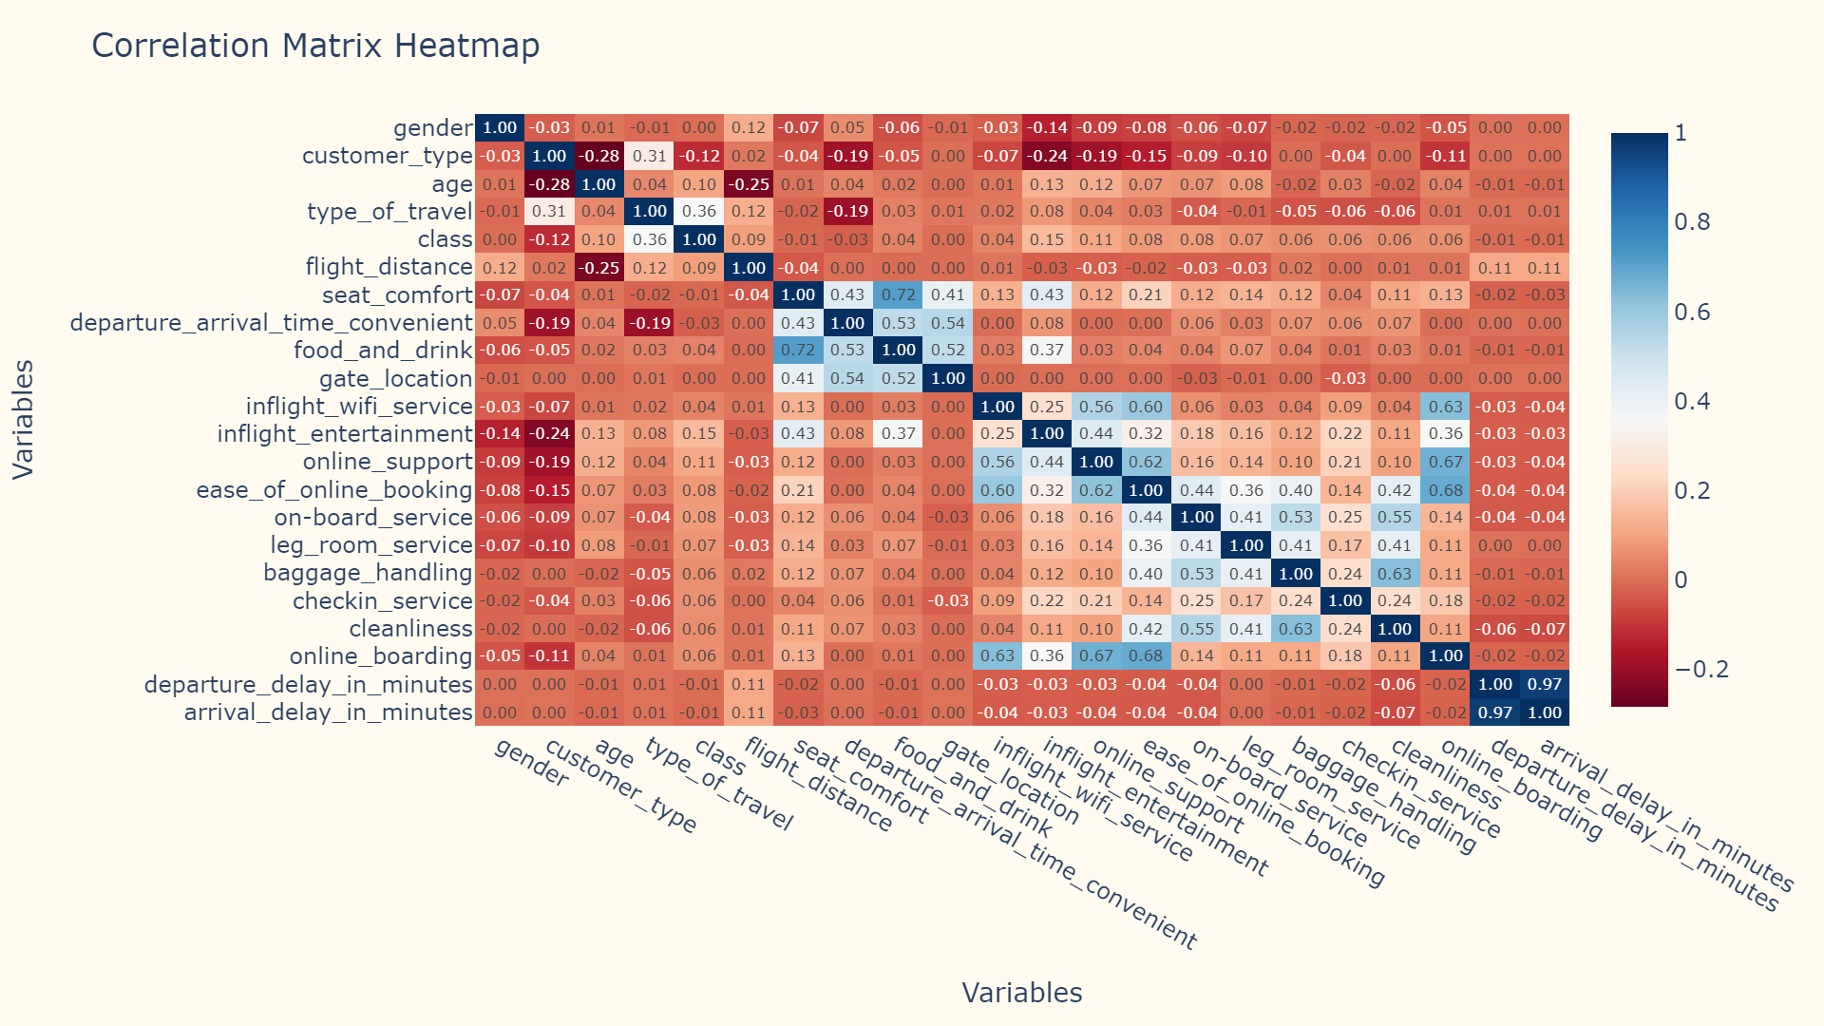
Notes:
This is the correlation matrix heat map that shows the relationships between the variables or aspects that passengers were asked to rate. The colors indicate strength and direction of the correlations. Dark blue representing strong positive correlations, dark red representing strong negative correlations, and white indicating weak or no correlation.

Slide 12
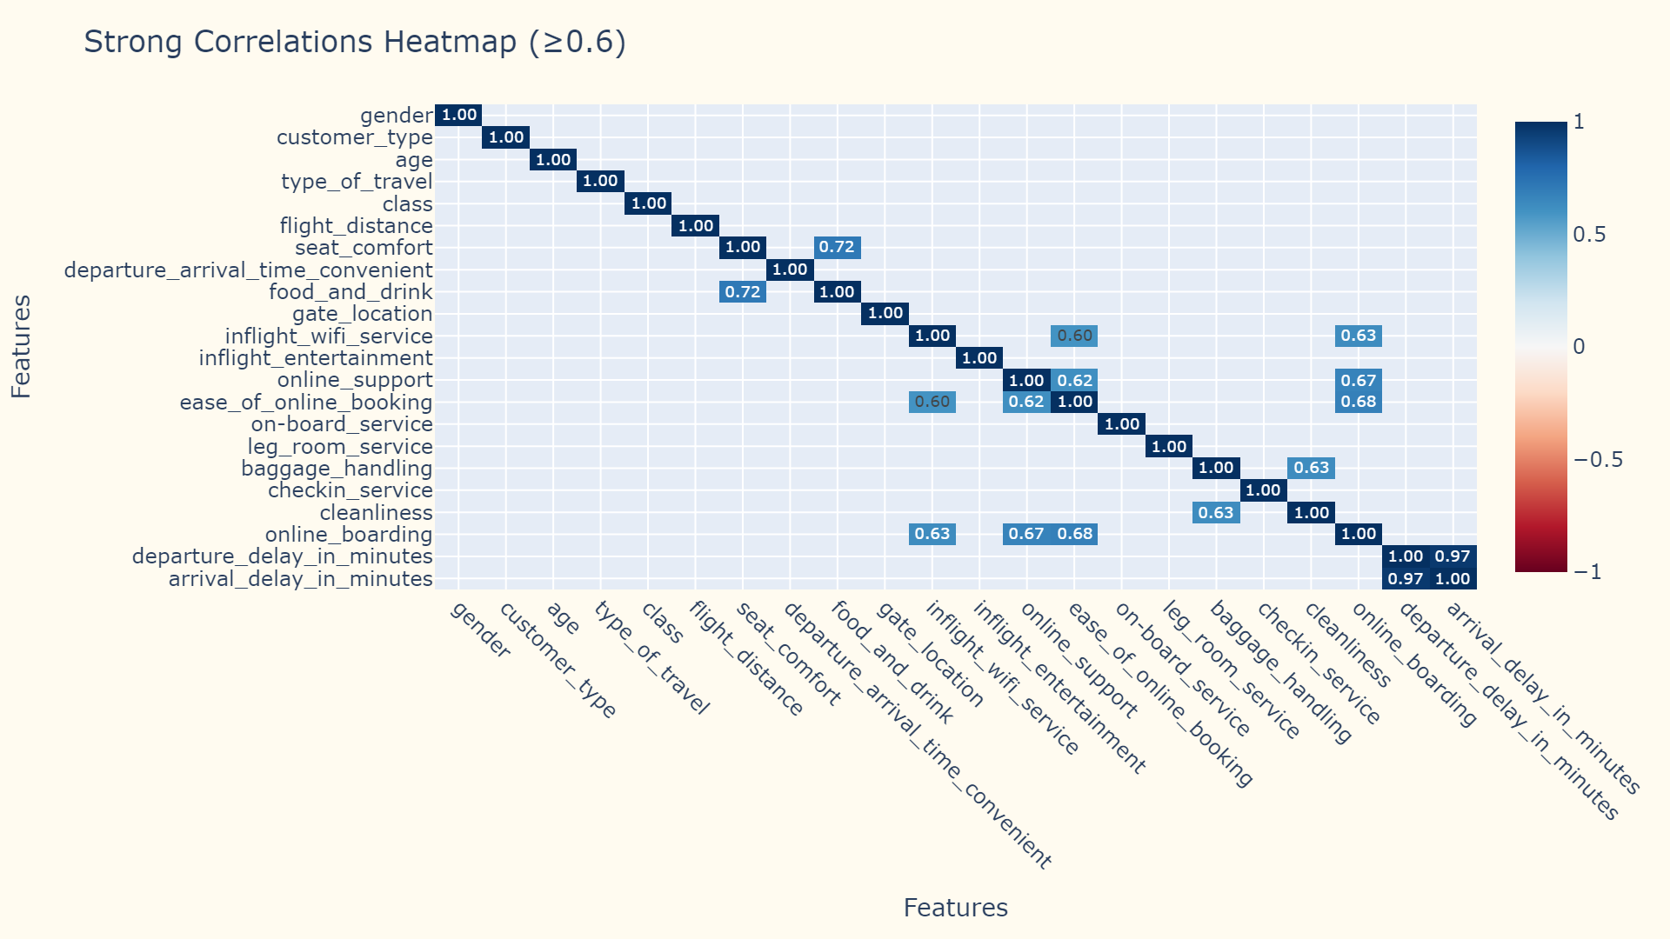
Notes:
We’ve now simplified the heat map to focus on the strong relationships to show correlations that are 0.6 or higher. Some notably high correlations are:
Online boarding with both ease of online booking and online support
Seat comfort with food and drink
Baggage handling with cleanliness

Slide 13
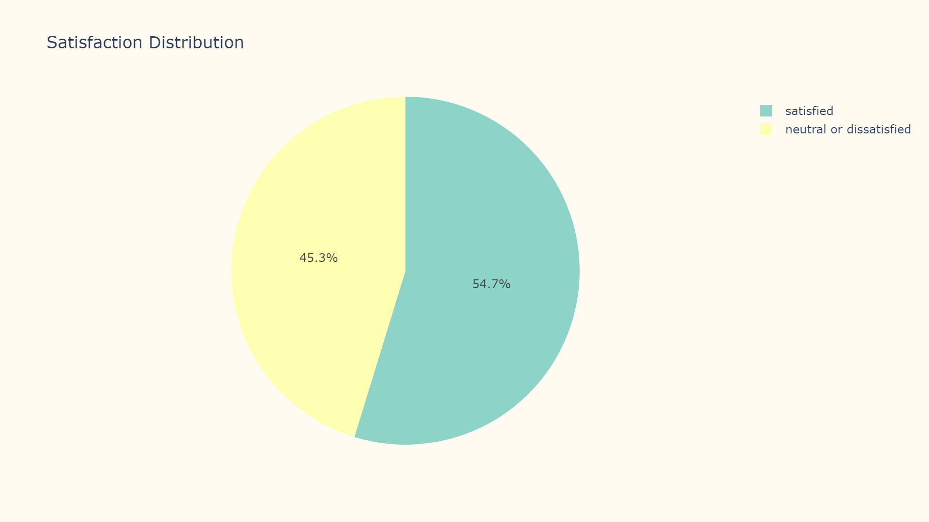
Notes:
This pie chart represents the distribution of passengers that were ultimately satisfied or dissatisfied with their flight experience. About 55% are satisfied overall and 45% are neutral or dissatisfied

Slide 14
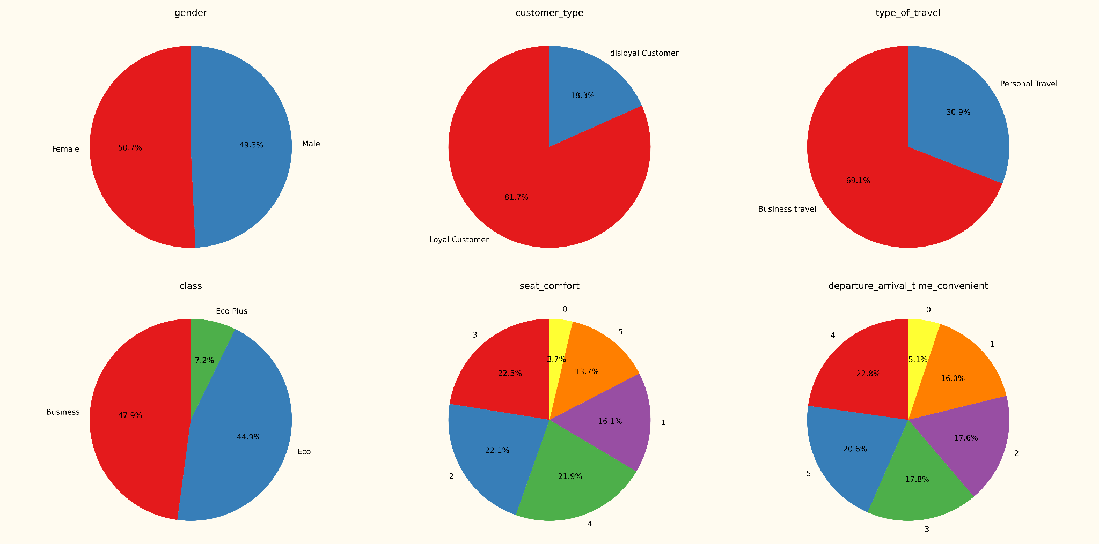
Notes:
The next three slides will show the distribution of passengers and their ratings 0-5 of each of the 14 aspects.
About 82% of passengers are loyal customers. 70% were traveling for business. 48% sat in business class, 45% were in economy, and 7% were in economy plus.
Some of these aspects’ ratings were more evenly distributed than others. For example, departure/arrival time, gate location, inflight wifi service are pretty even across the 0-5 ratings.
Other aspects were more skewed towards 4 or 5 ratings.

Slide 15
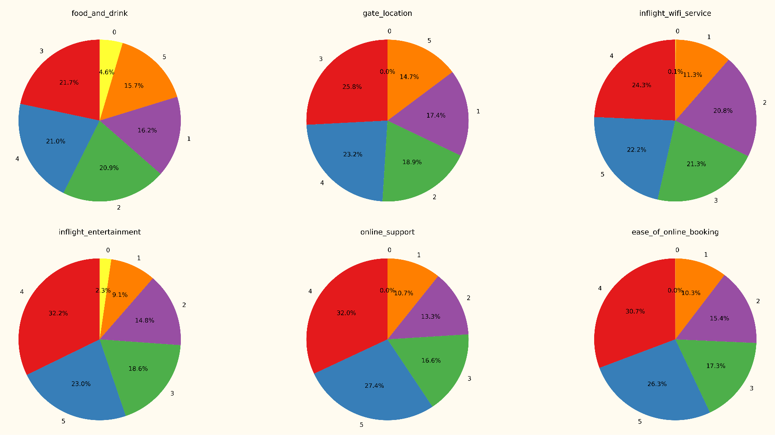
Notes:
Inflight entertainment was rated 4 or 5 by 55% of passengers. Online support and ease of online booking were rated 4 or 5 by about 58% of passengers

Slide 16
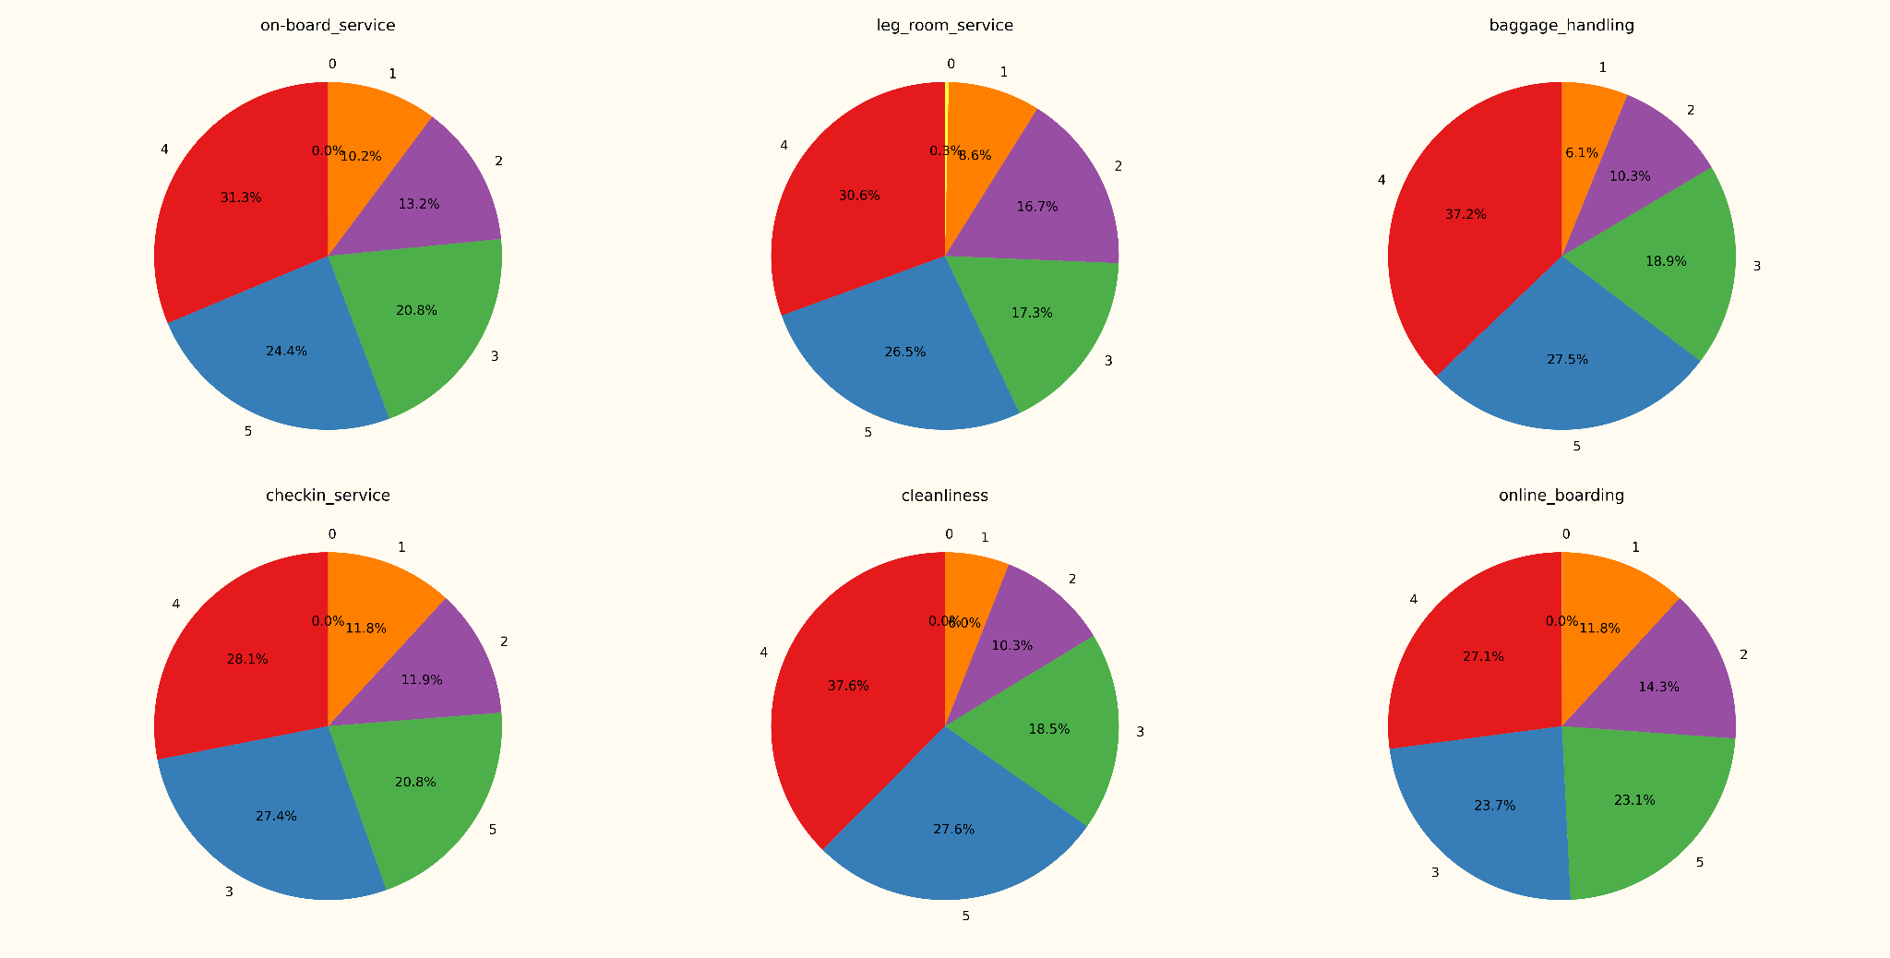
Notes:
On-board service, leg room, and check-in service were all rated 4 or 5 by about 56% of passengers, baggage handling and cleanliness were each rated 4 or 5 by 65% of passengers, and online boarding was rated 4 or 5 by 51% of passengers.

Slide 17
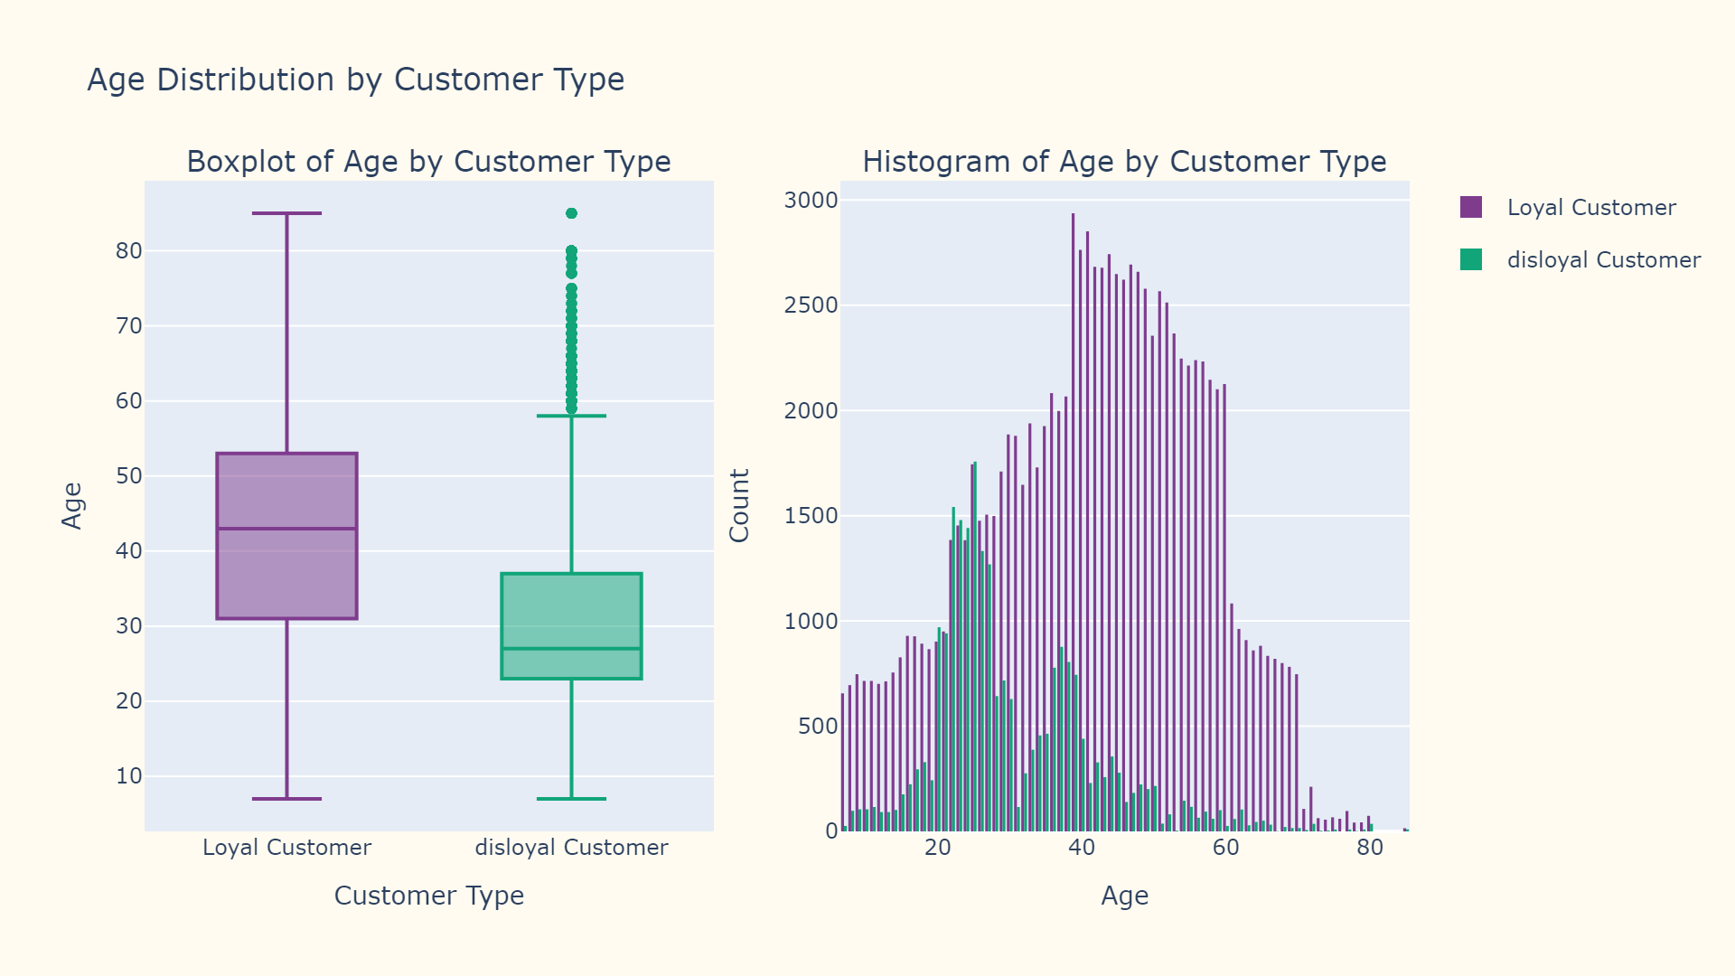

Slide 18
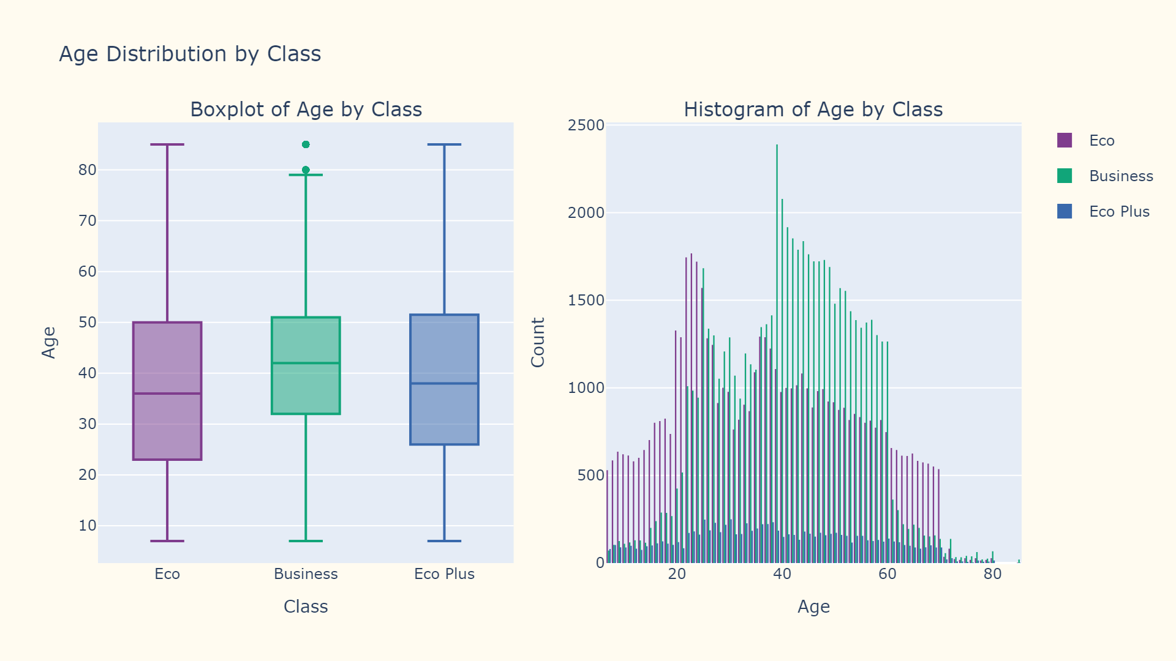

Slide 19
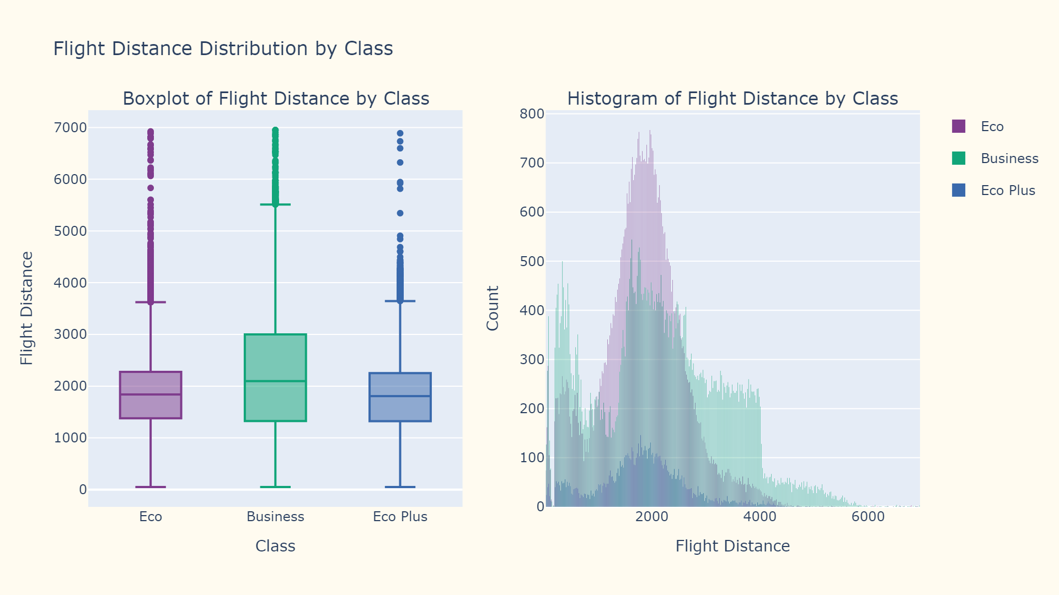

Slide 20
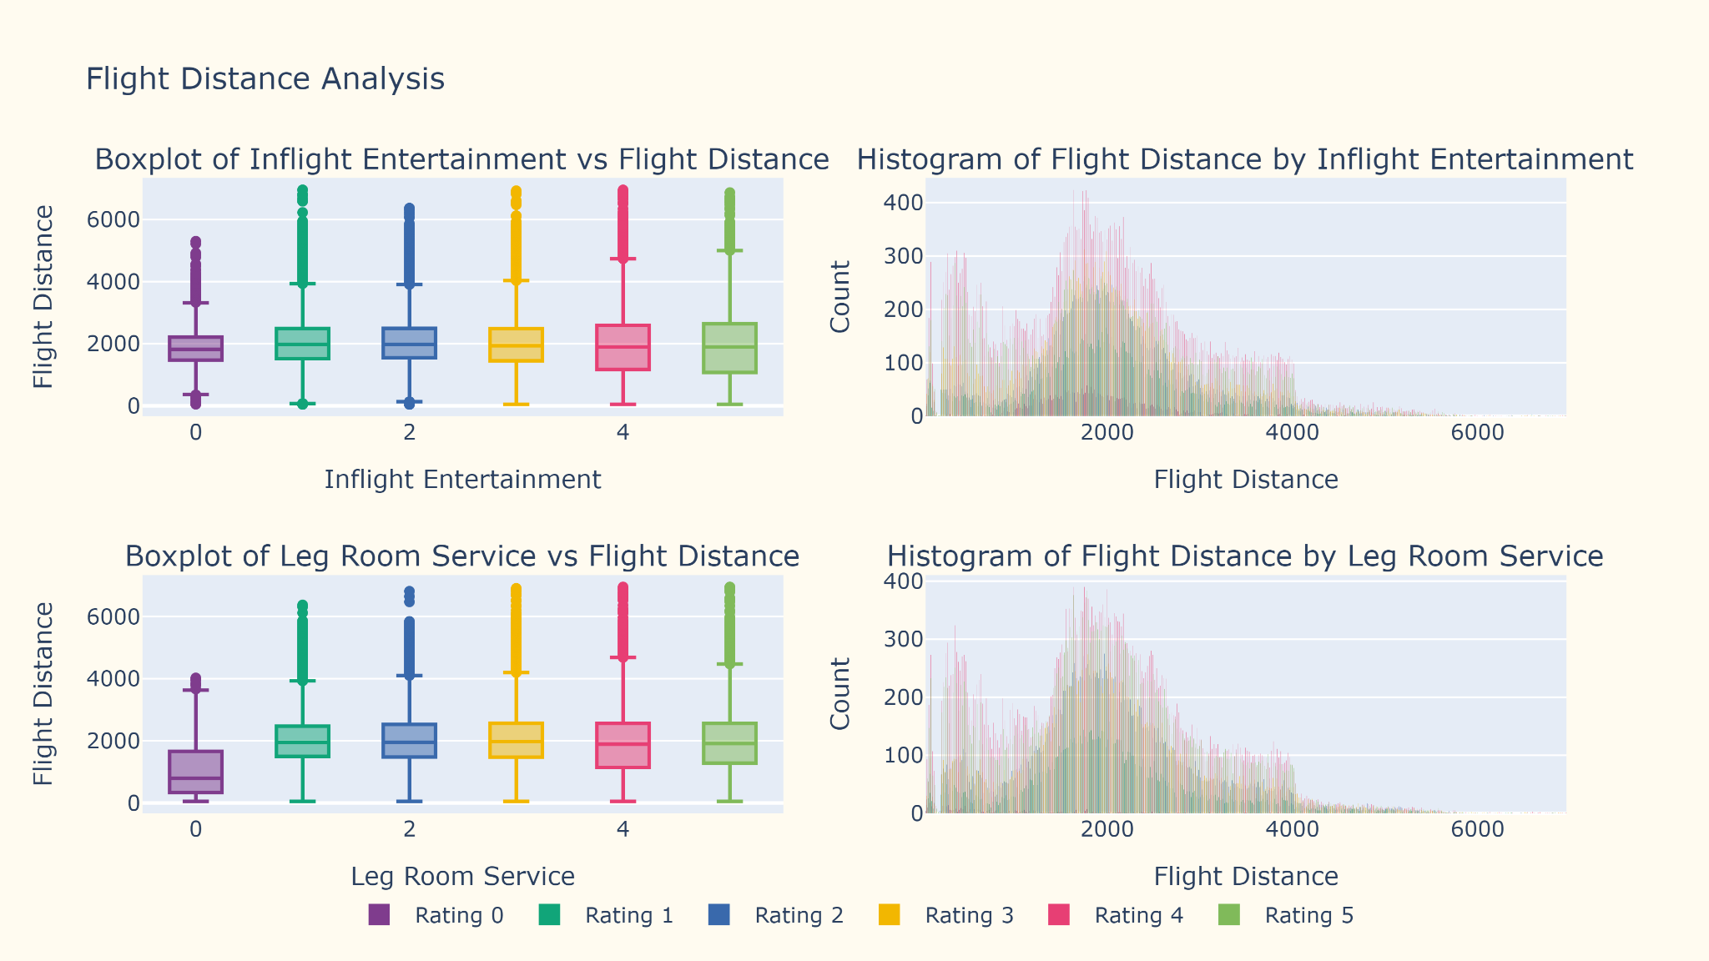

Slide 21
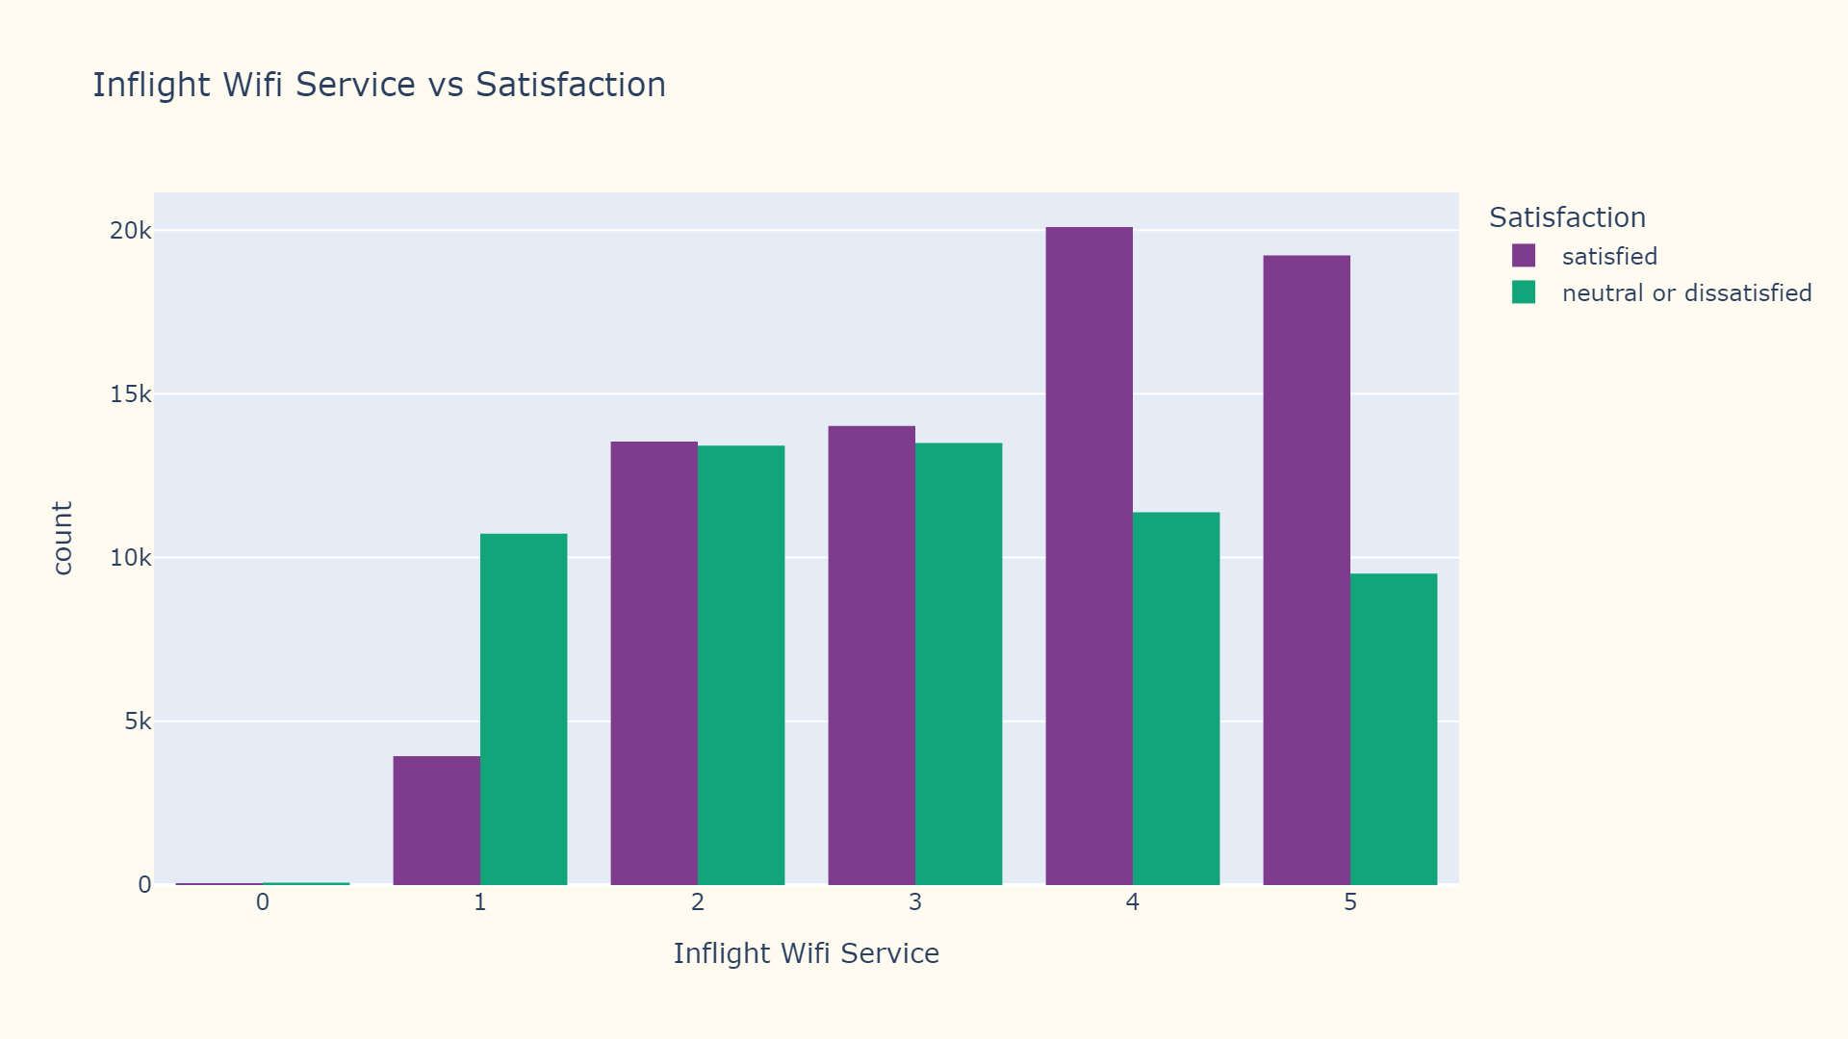

Slide 22
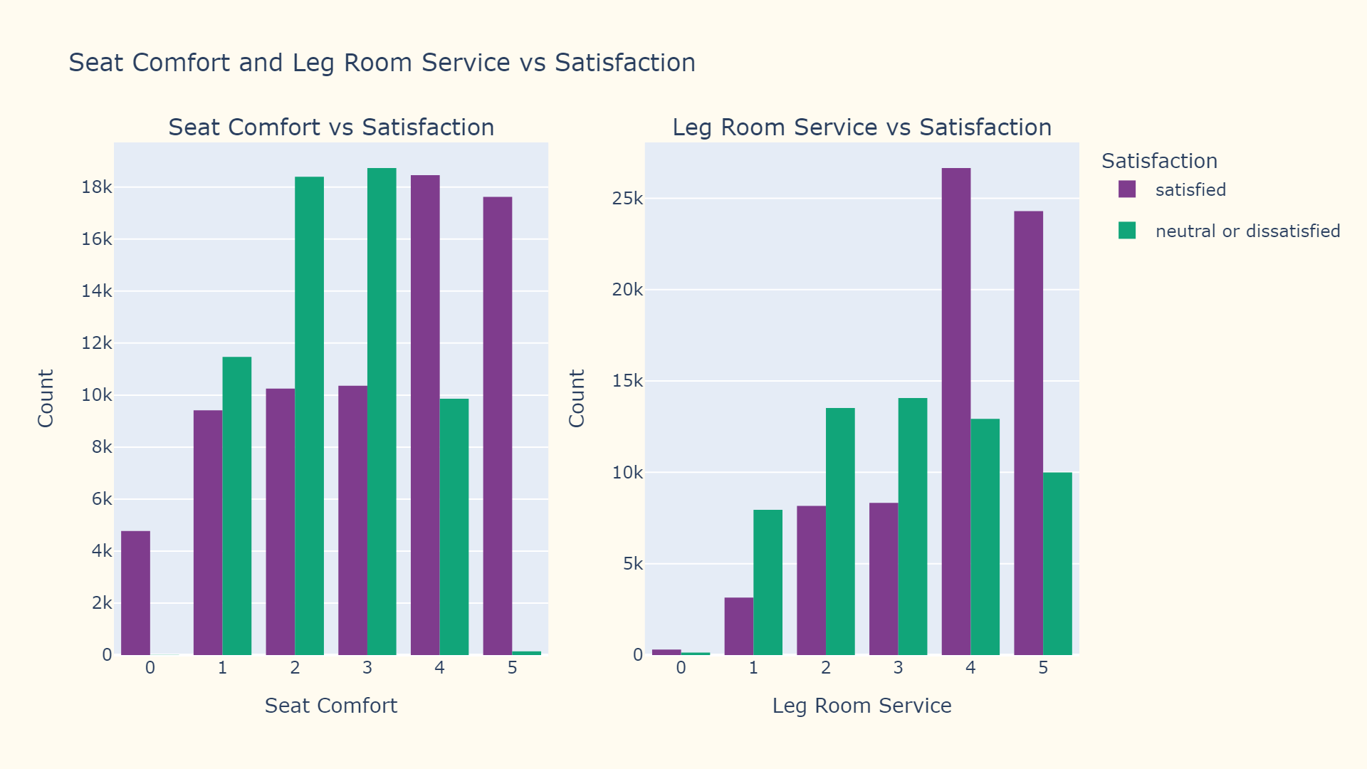

Slide 23
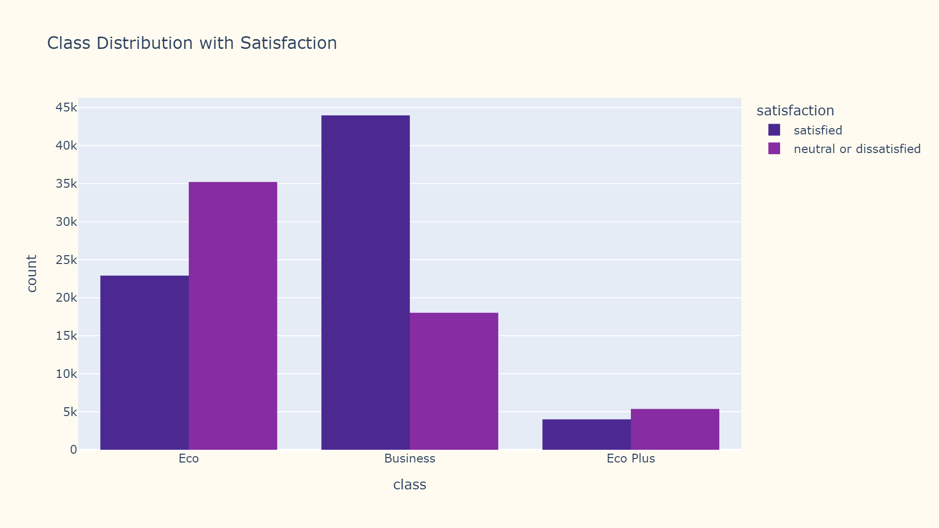

Slide 24
Data Preprocessing

Slide 25
Removed redundant identifier column 'id' to focus on relevant features for ML model training
Improved data readability through systematic column renaming and standardization (lowercase, underscores for spaces)
Removed the null values in the data as they were minimal and would not affect training in any way
Standardized target variable name from 'satisfaction_v2' to 'satisfaction' for clarity
Structured the departure/arrival time feature name for improved code maintainability

Slide 26
Implemented Label Encoding for categorical variables, transforming them into numerical format for model compatibility
Preserved Label Encoder mappings by serializing to 'label_encoder.pkl' for consistent future predictions
Implemented data partitioning using train_test_split with 85% training and 15% testing split
Applied StandardScaler for feature normalization to ensure all features contribute equally to model training
Preserved original feature distributions while normalizing data to mean=0 and standard deviation=1

Slide 27
Model Training

Slide 28
Logistic Regression
Accuracy: 83.51%
Precision: 84%
Recall: 84%
F1 Score: 84%
Hyperparameters
Max Iterations - 1000
Penalty - l2
Solver - lbfgs

Slide 29
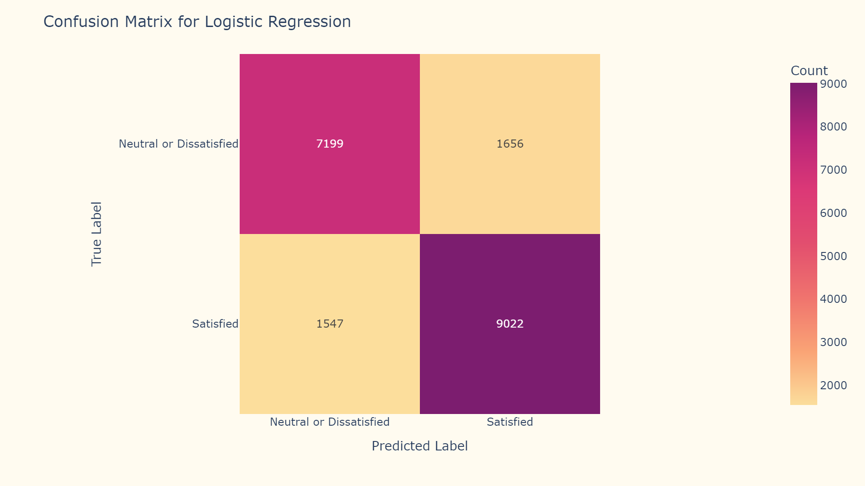

Slide 30
K Nearest Neighbors
Best Model: K=9
Accuracy: 92.48%
Precision: 93%
Recall: 92%
F1 Score: 92%
Hyperparameters
K - 2 to 15
Weights - uniform
Algorithm - auto
Metric - minkowski
P - 2

Slide 31
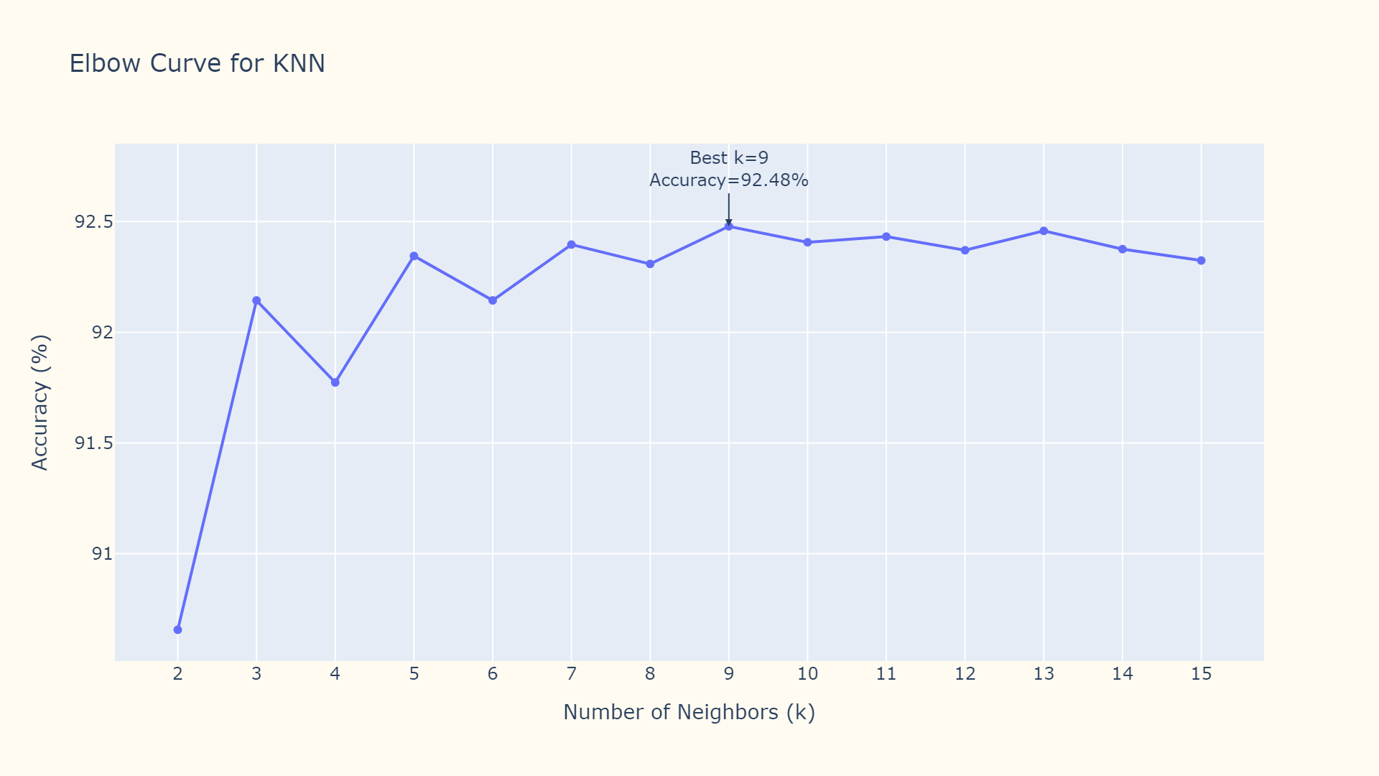

Slide 32
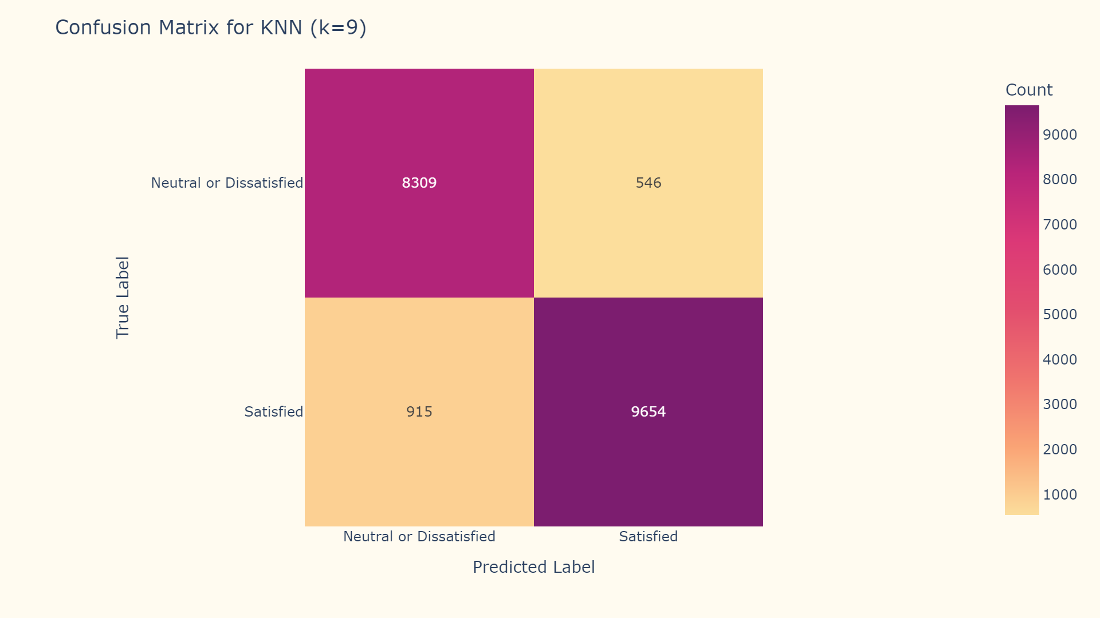

Slide 33
Decision Tree Classifier
Accuracy: 94.96%
Precision: 95%
Recall: 95%
F1 Score: 95%
Hyperparameters
Criterion - entropy
Splitter - best
Max Depth - 20
Notes:
For the Decision Tree Classifier we used hyper parameters: criterion entropy, splitter best, and max depth of 20. entropy measures the impurity or randomness in a dataset and is used by decision trees to determine the best splits for achieving pure subsets of data. Splitter best chooses the optimal split at each node, and max depth of 20 limits the maximum depth of the tree to prevent overfitting
Accuracy of the decision tree classifier is 94.96%
There is high performance across the board with precision, recall, and f1-score all at 95%, so the model is effective at identifying both satisfied and dissatisfied customers
Pure subsets - subset of data where all data points belong to the same class or category

Slide 34
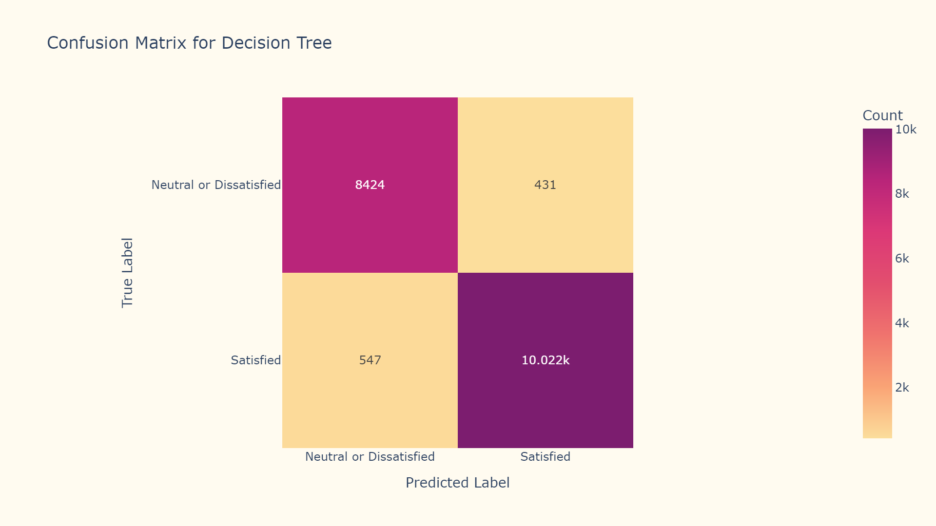
Notes:
This is the confusion matrix for the decision tree classifier. As you can see, there are very few false negatives and false positives indicating that the the model makes very few errors

Slide 35
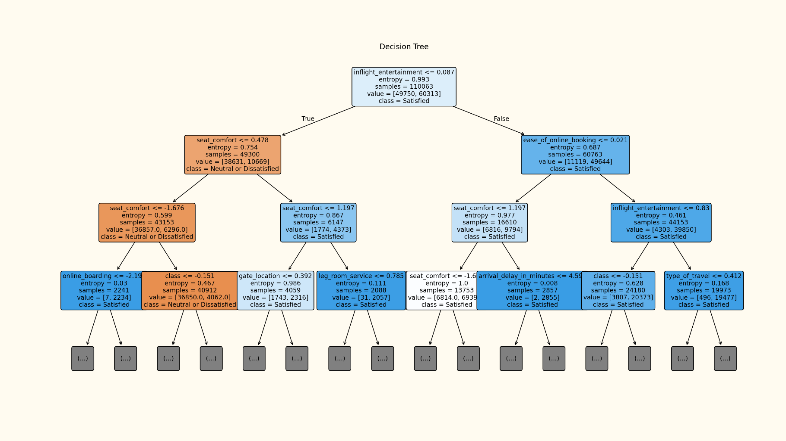
Notes:
Here is what the decision tree plot looks like. This shows the first 3 levels of depth of the decision tree. There are so many variables it got very busy to show on the slide but it is included with our code file.

Slide 36
Random Forest Classifier
Accuracy: 95.91%
Precision: 96%
Recall: 96%
F1 Score: 96%
Hyperparameters
Estimators - 500
Criterion - log_loss
Max Depth - 20
Notes:
For the random forest classifier we used hyper parameters: 500 estimators, criterion log_loss, and max depth 20. Estimators 500 specifies that the random forest will consist of 500 individual decision trees whose outputs are then combined to improve predictive performance. Criterion log_loss measures how well the model’s probability predictions match the actual outcomes. same as in the decision tree classifier, max depth of 20 limits the maximum depth of the tree to prevent overfitting by ensuring the trees are not overly complex
Accuracy of the random forest classifier is 95.91%,
There is also high performance across the board for random forest with precision, recall, and f1-score all at 96%, so the model is effective at identifying both satisfied and dissatisfied customers

Slide 37
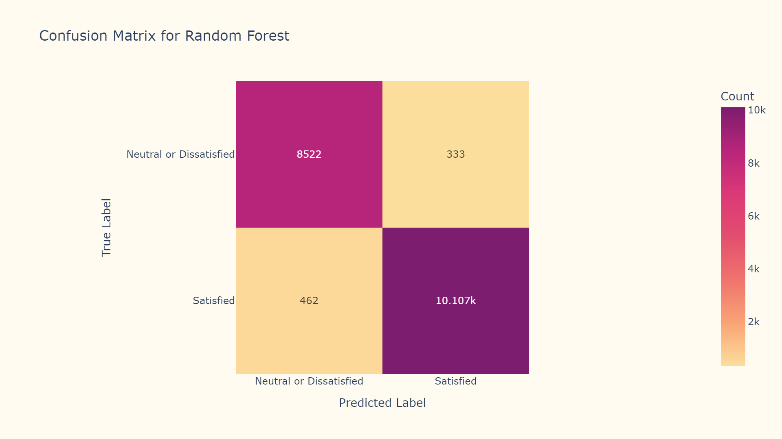
Notes:
This is the confusion matrix for the random forest classifier. As you can see, there are even fewer false negatives and false positives with the random forest as there were for the decision tree classifier, indicating that the model also makes very few errors

Slide 38
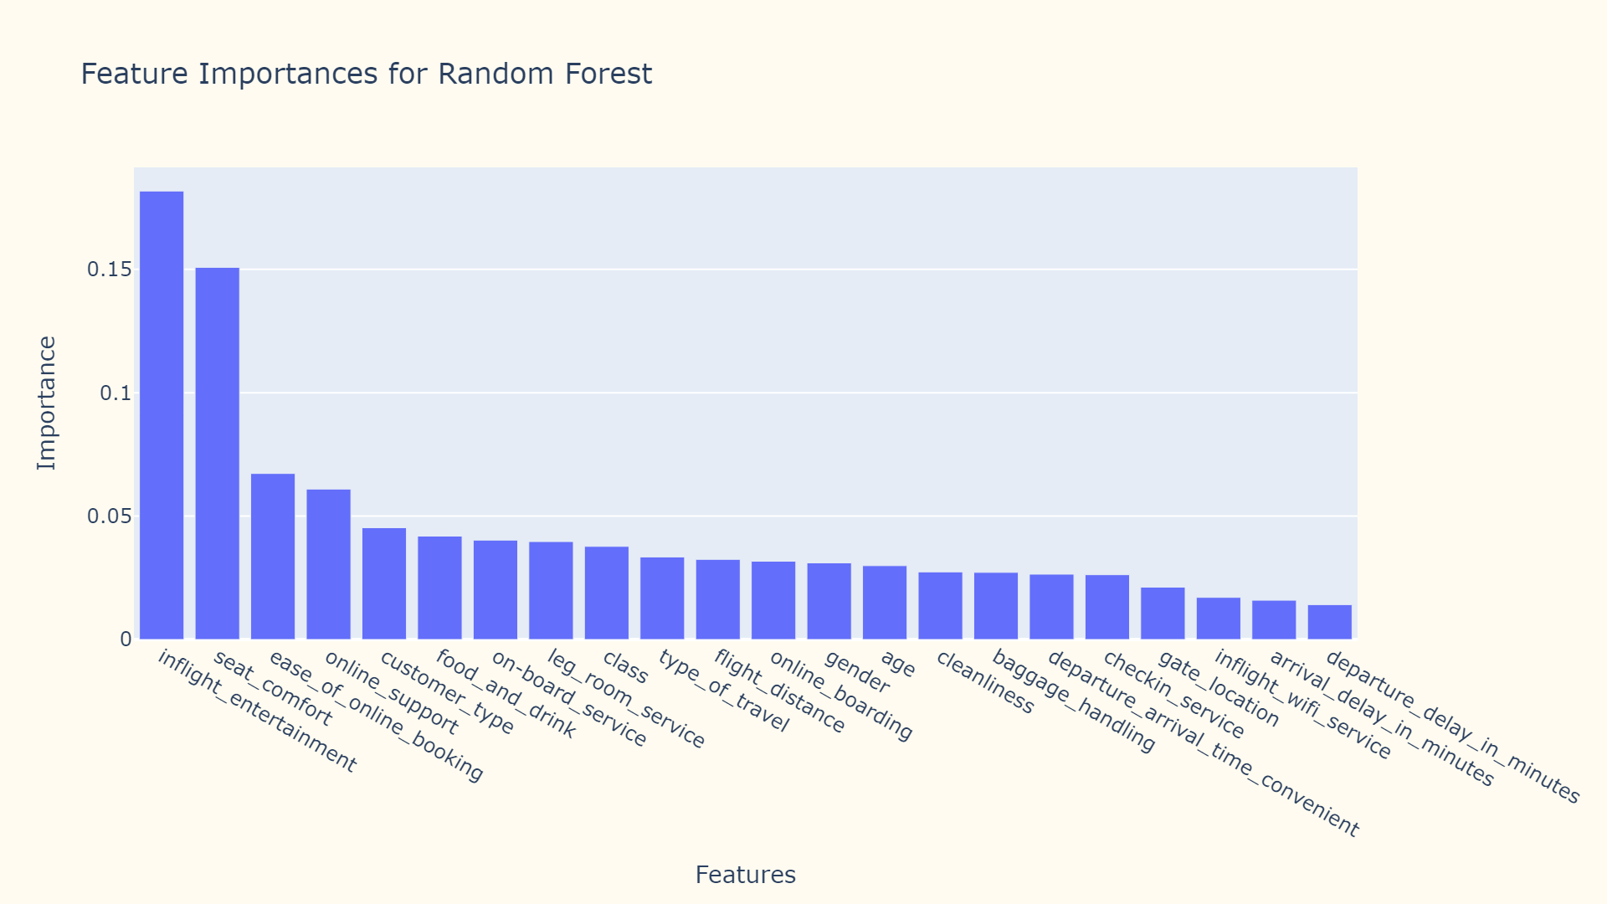
Notes:
This table shows the feature importances for random forest. This shows how much each feature contributes to the model’s decision-making process/which features have the most influence on the model’s output. As you can see from the chart, inflight entertainment and seat comfort are most important, followed by ease of online booking and online support. Departure and arrival delays, and inflight wifi service are least important in determining the passenger’s satisfaction.

Slide 39
Support Vector Machines
Accuracy: 94.88%
Precision: 95%
Recall: 95%
F1 Score: 95%
Hyperparameters
Kernel - rbf
Gamma - scale

Slide 40
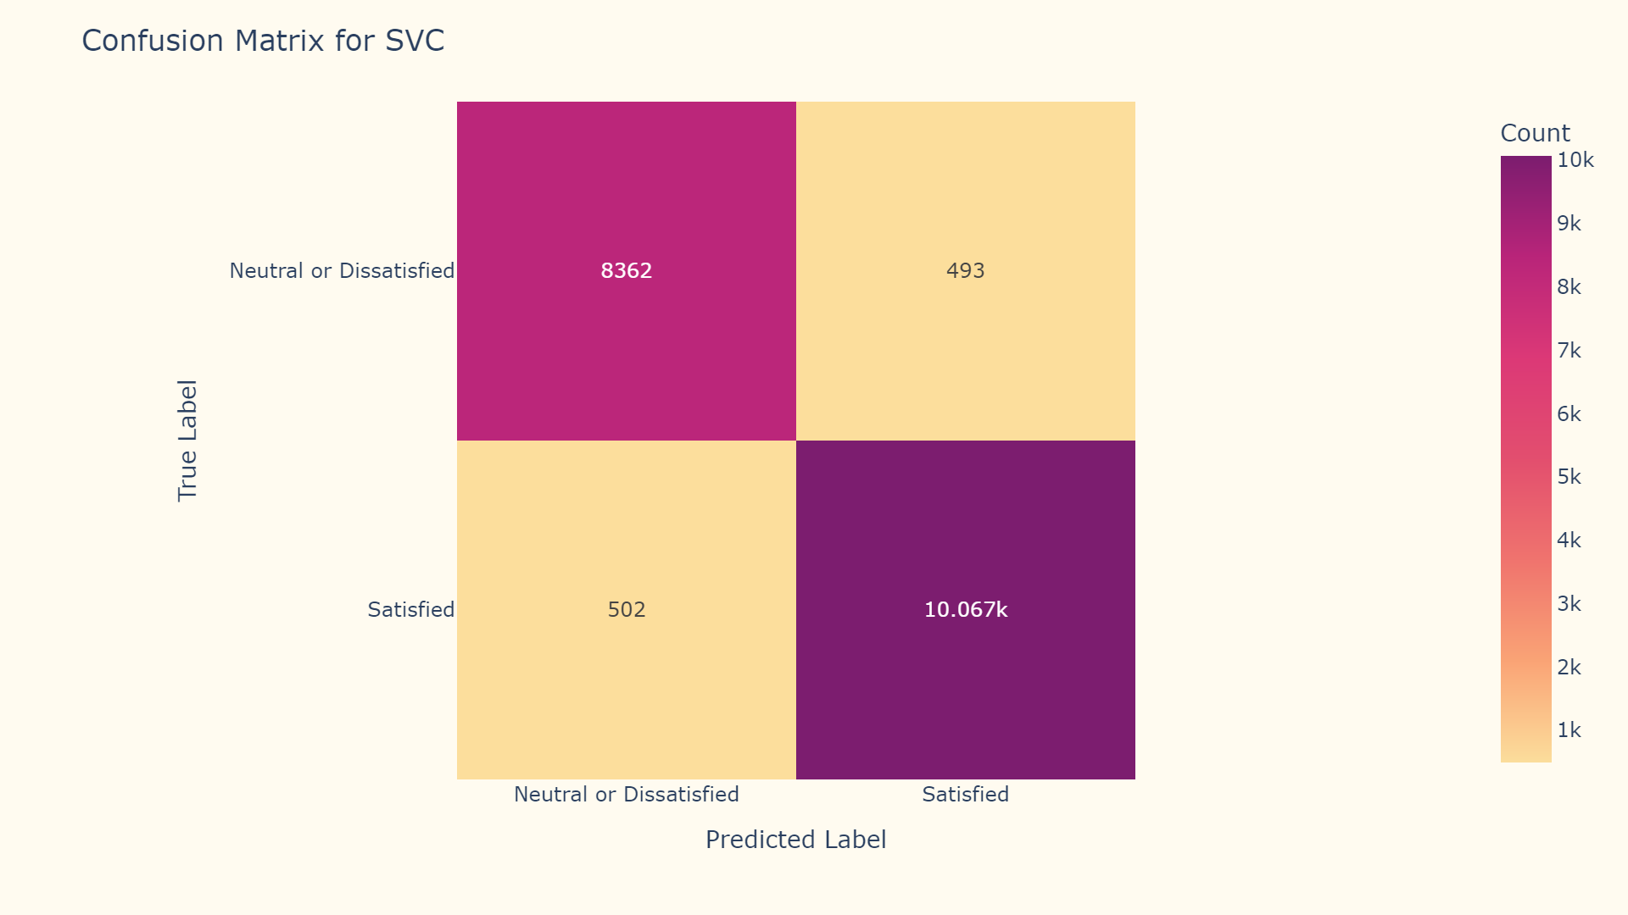

Slide 41
Artificial Neural Network(LSTM)
Accuracy: 95.88%
Precision: 96%
Recall: 96%
F1 Score: 96%
Hyperparameters
Total layers: 6 (2 Dense, 2 LSTM, 1 Reshape, 1 Output)
Parameters: 21,604
Activation Functions: ReLU (Rectified Linear Unit) for Dense Layers and Softmax for Output Layer
Optimizer: Adam(learning rate 0.001)
Loss function: Binary Cross-entropy
Max epochs: 100

Slide 42


Slide 43
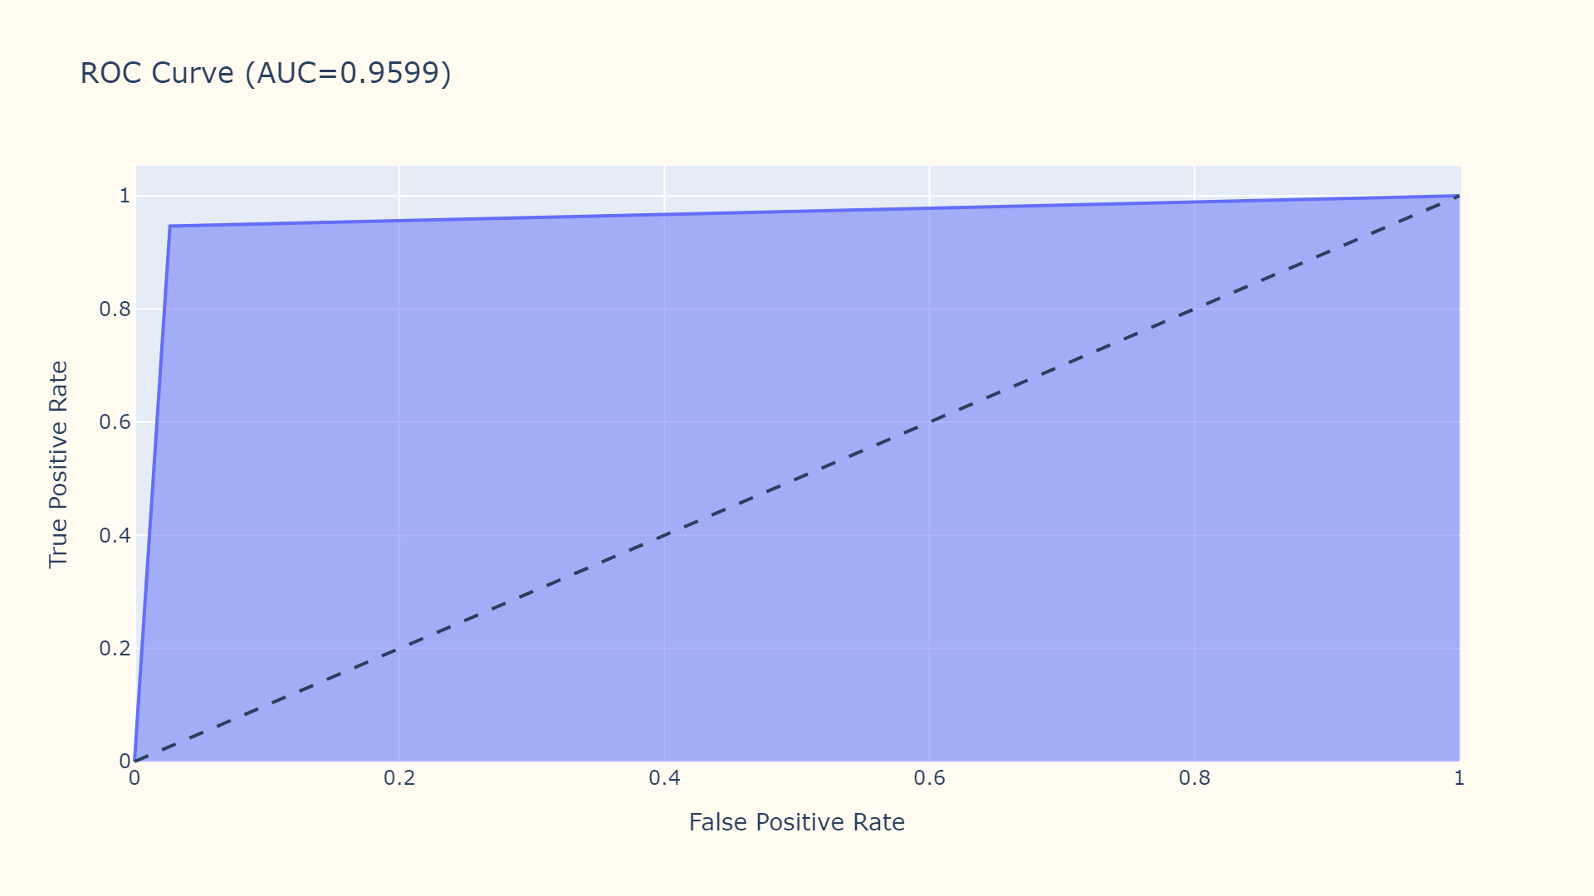

Slide 44
AdaBoost
Accuracy: 88.47%
Precision: 88%
Recall: 88%
F1 Score: 88%
Hyperparameters
Estimators - 1000
Learning Rate - 0.1
Algorithm - SAMME

Slide 45


Slide 46
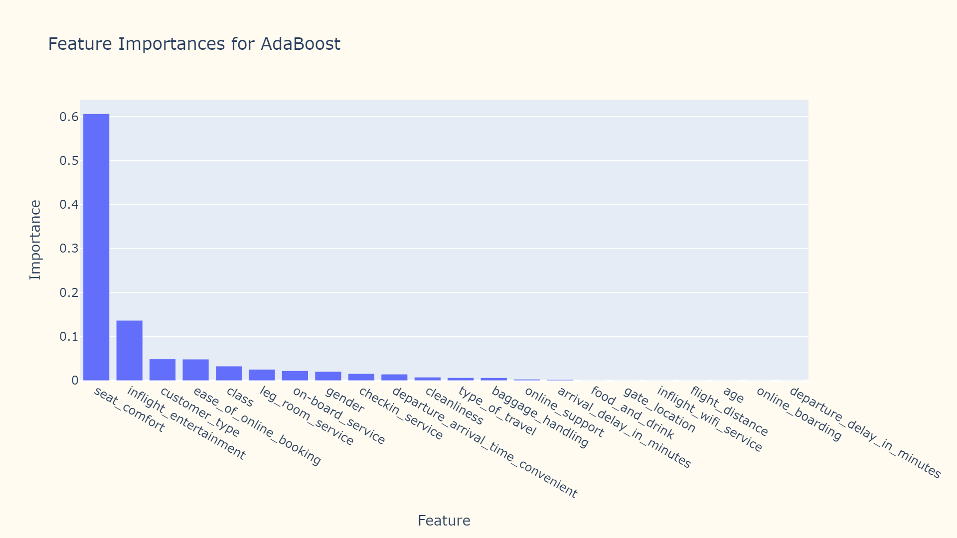

Slide 47
XG Boost
Accuracy: 96.04%
Precision: 96%
Recall: 96%
F1 Score: 96%
Hyperparameters
Estimators - 2000
Learning Rate - 0.05
Max Depth - 12
Subsample - 0.9
Colsample Bytree - 0.9

Slide 48


Slide 49
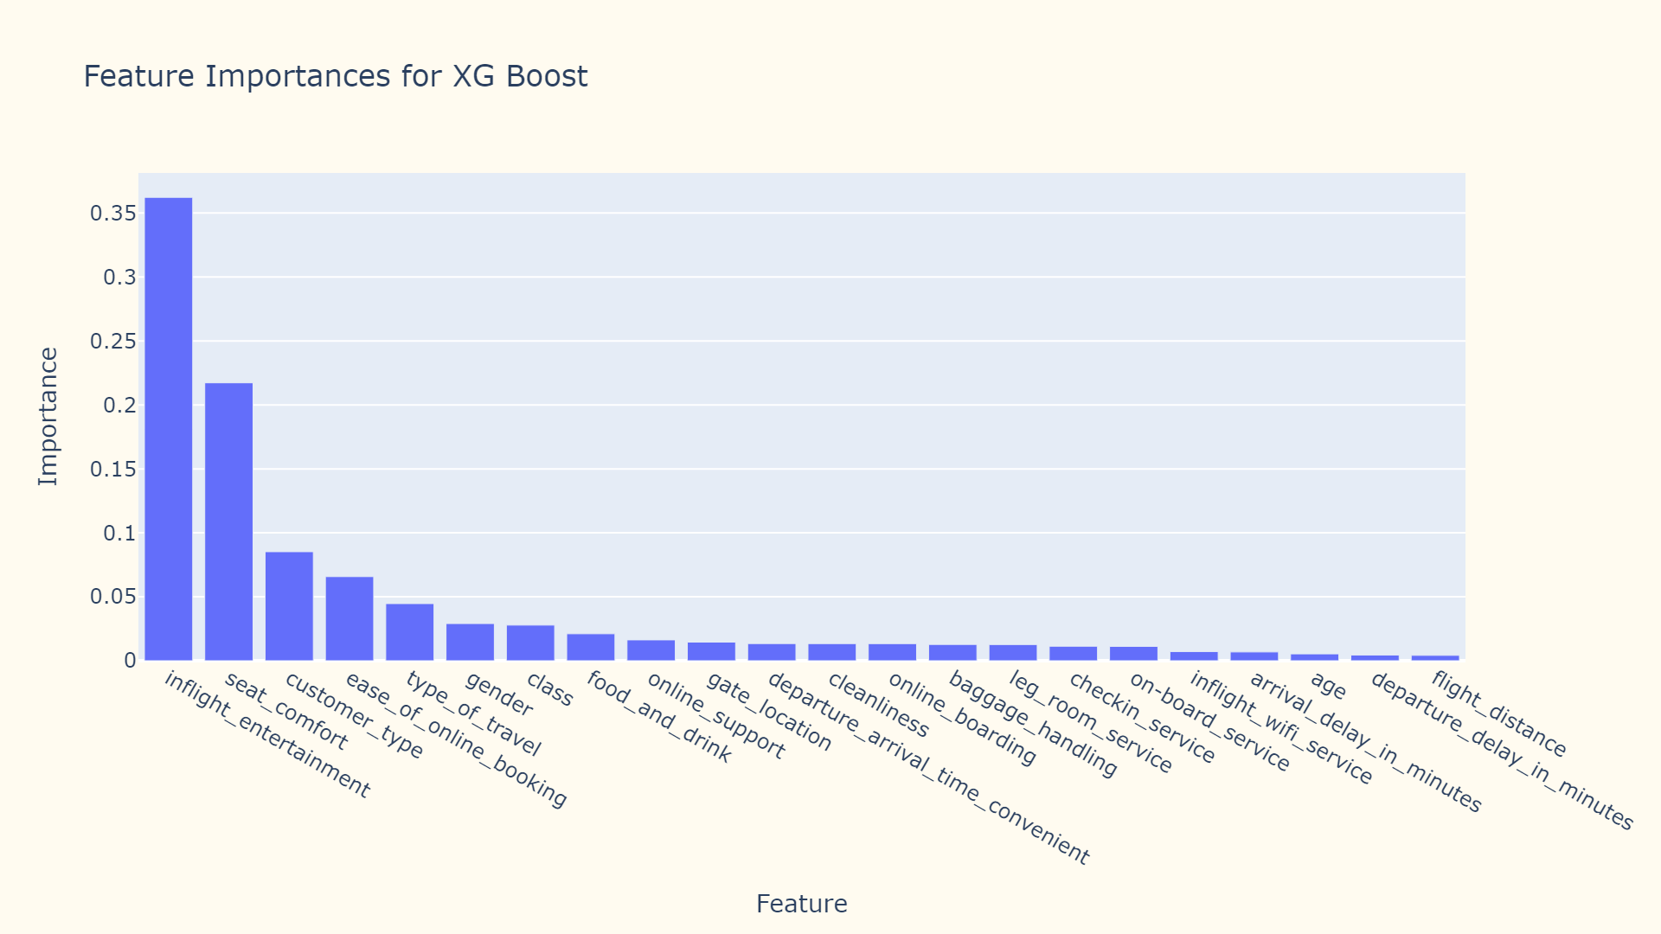

Slide 50
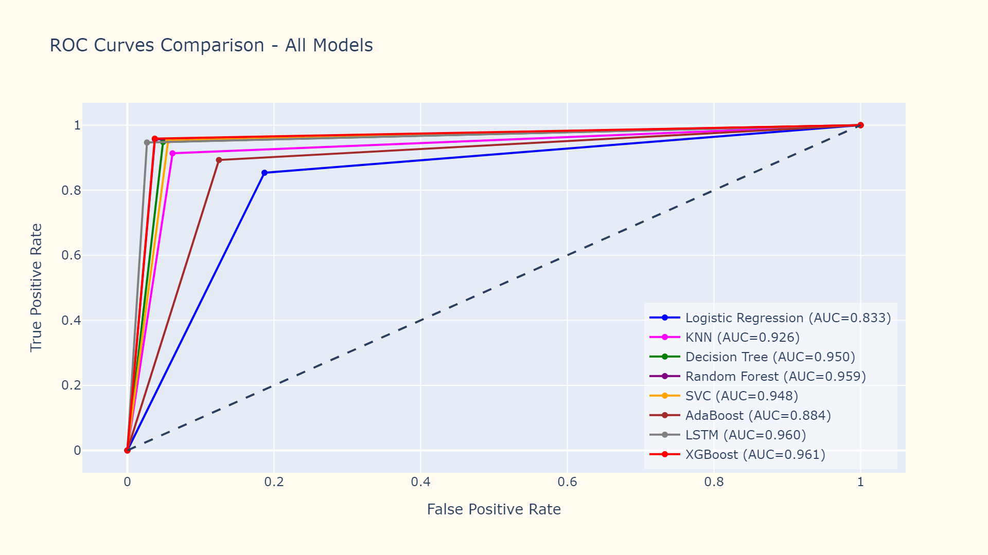

Slide 51
Model | Accuracy
XGBoost | 96.04%
Random Forest | 95.91%
Long Short Term Memory | 95.88%
Decision Tree | 94.96%
Support Vector Machines | 94.88%
K Nearest Neighbor(K = 9) | 92.48%
AdaBoost | 88.47%
Logistic Regression | 83.51%

Slide 52
Conclusion

Slide 53
Associating In-flight services with customer satisfaction was a crucial step in the Exploratory Data Analysis
XGBoost and Random Forest models are performing extremely well on this dataset
ANN with LSTM almost matched XGBoost on the test set but it had an extremely lengthy training time
The next steps of this project is to train the models for different ratios of data split
Since XGBoost and Random Forest are the top performing models, the objective is to focus on these algorithms with different hyperparameters

Slide 54
Thank you!
GitHub: https://github.com/PradHolla/KDDM-Final-Project

